Slide 1
Story Board
Presented By: 8-Bit Bacon

Slide 2
Player
A strong and noble human warrior.
Uses a mystical sword containing the powers of fire and ice.
On a journey to save his lost love.

Slide 3
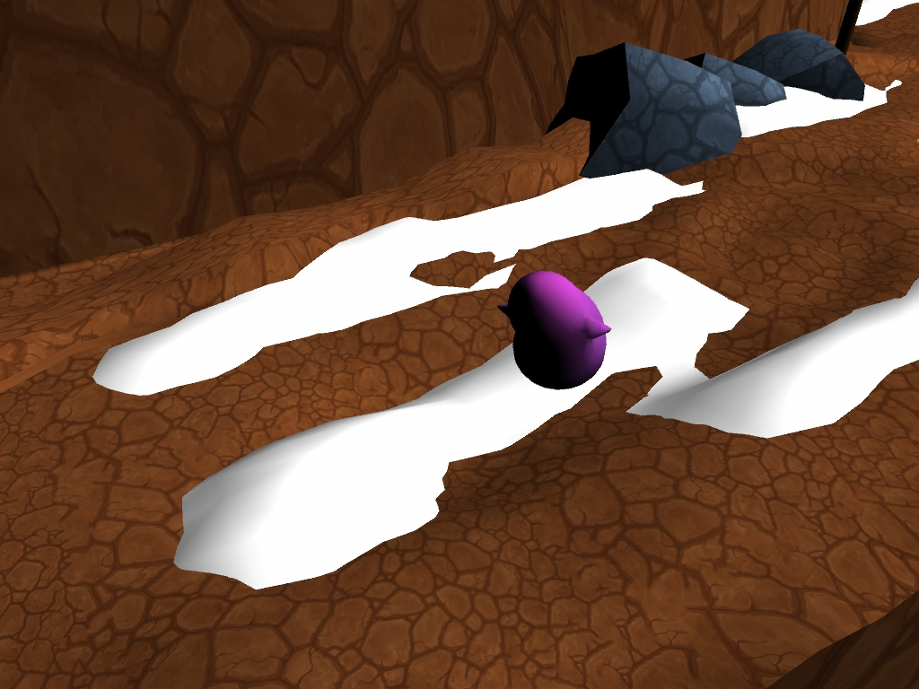
Melee Minion
A small blob creature with little facial features and two arms.
Does weak physical damage to the player.
Dangerous in large groups.
Can be frozen or burned.

Slide 4
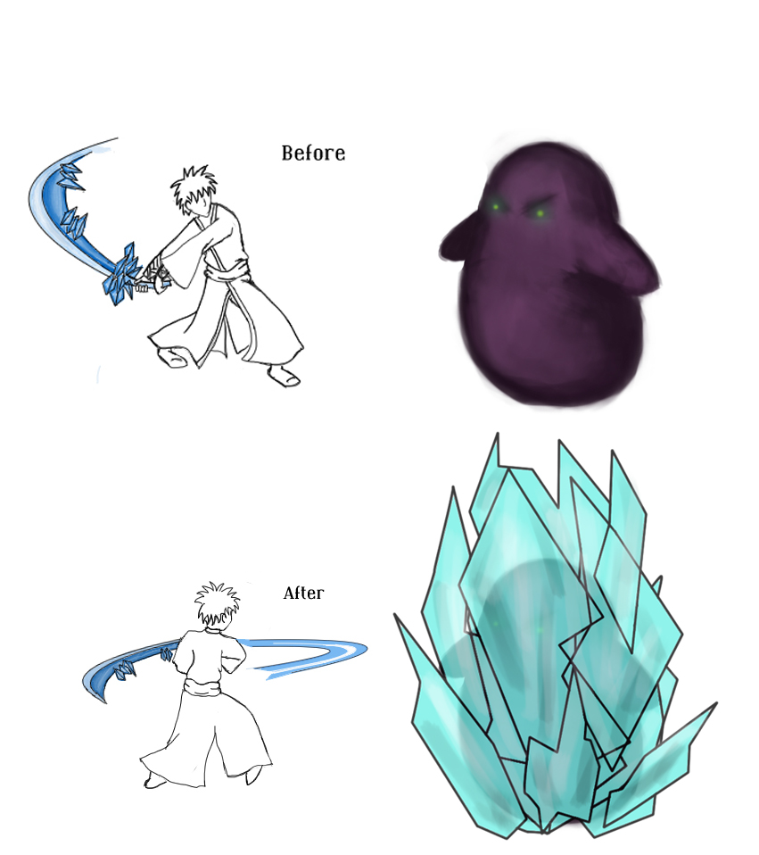
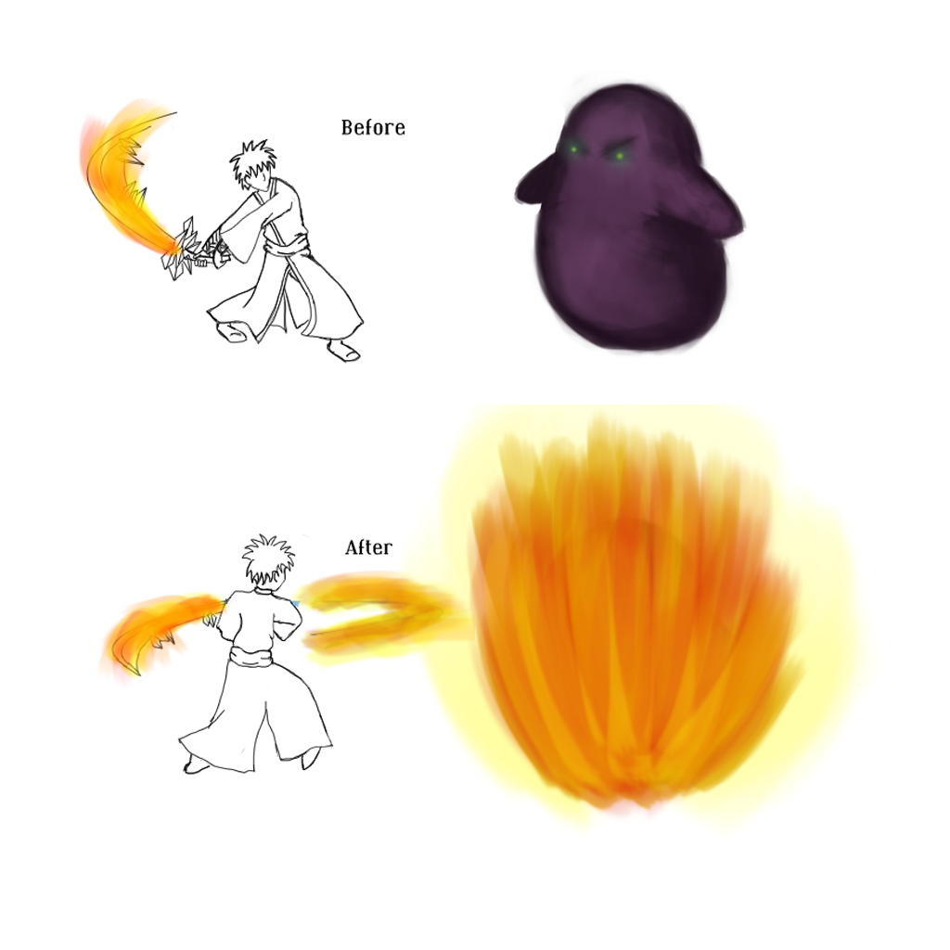
Freezing and Burning (Concept)

Slide 5
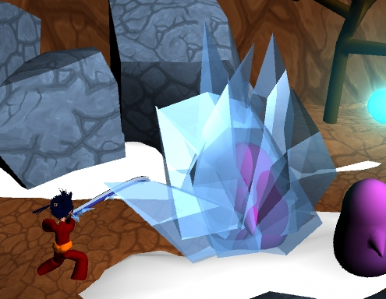
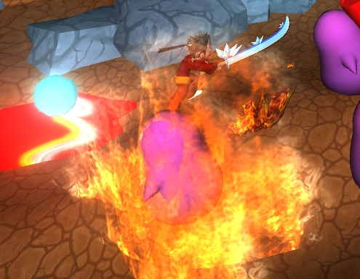
Freezing and Burning (In Game)
Not cool bro!

Slide 6
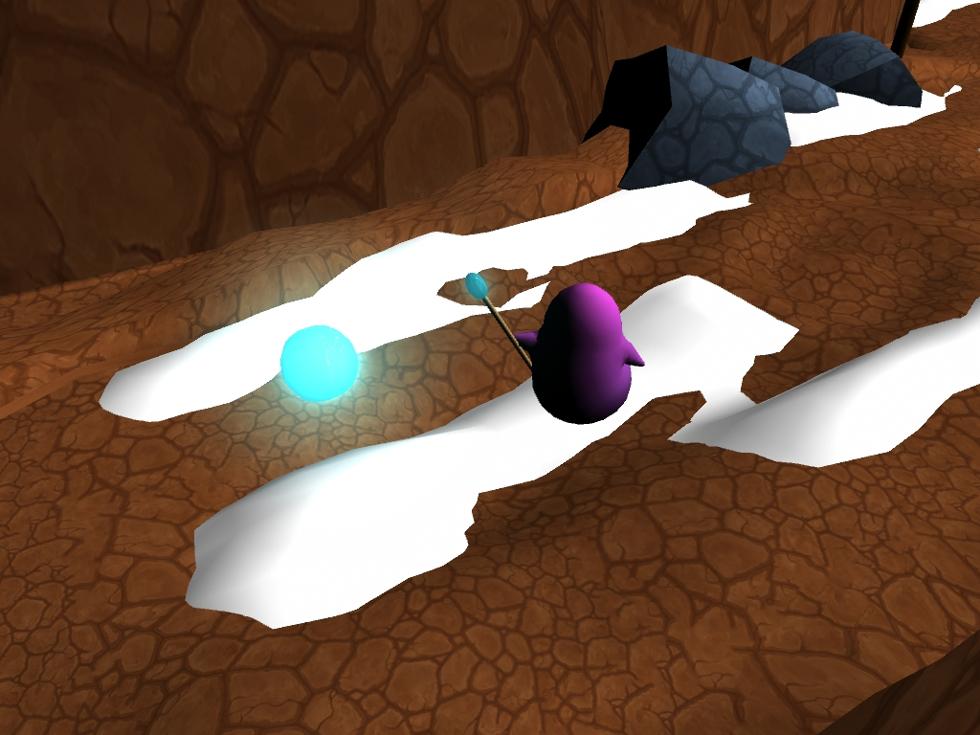
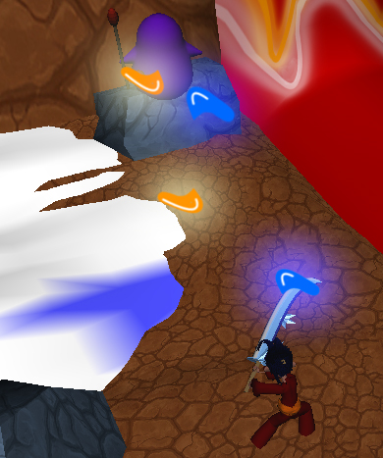
Ranged Minion
Similar to the melee minion except he caries a staff to cast ranged spells.
Casts ranged spells at the player and causes medium damage to the player.
Can be killed with their own attack deflected back at them.
Can be frozen or burned.

Slide 7
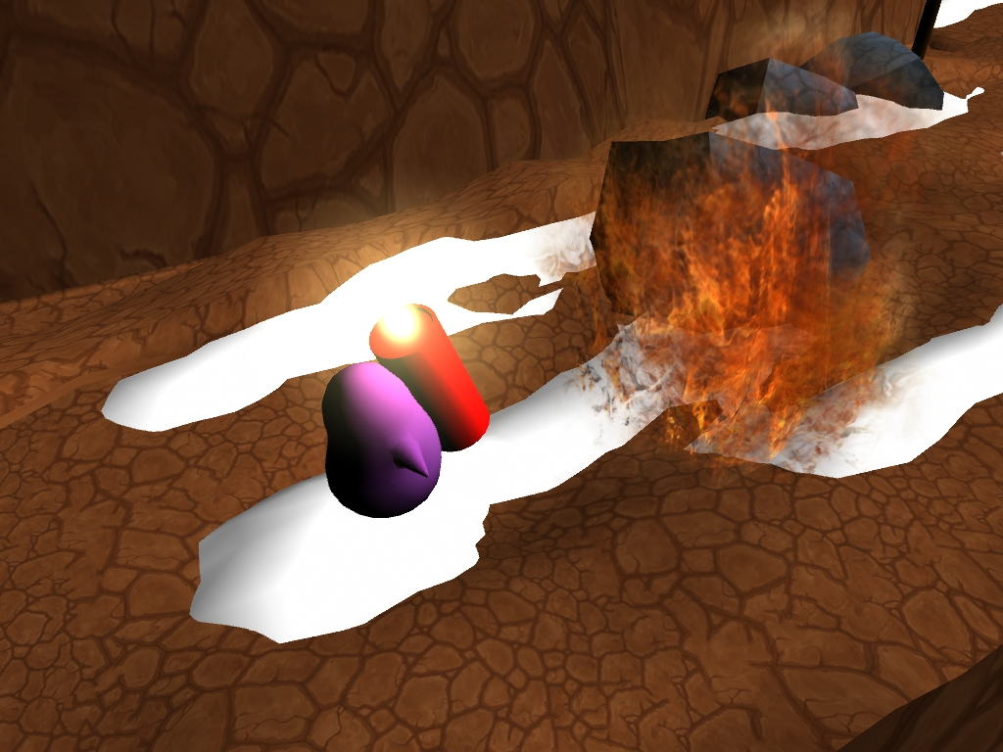
Explosive Minion
Similar to the melee minion except he has a large bomb strapped to his back.
Does massive damage to the player when he explodes.
Dangerous on its own or in groups.
Ice will put out his bomb if lit
Fire will ignite and immediately explode his bomb.

Slide 8
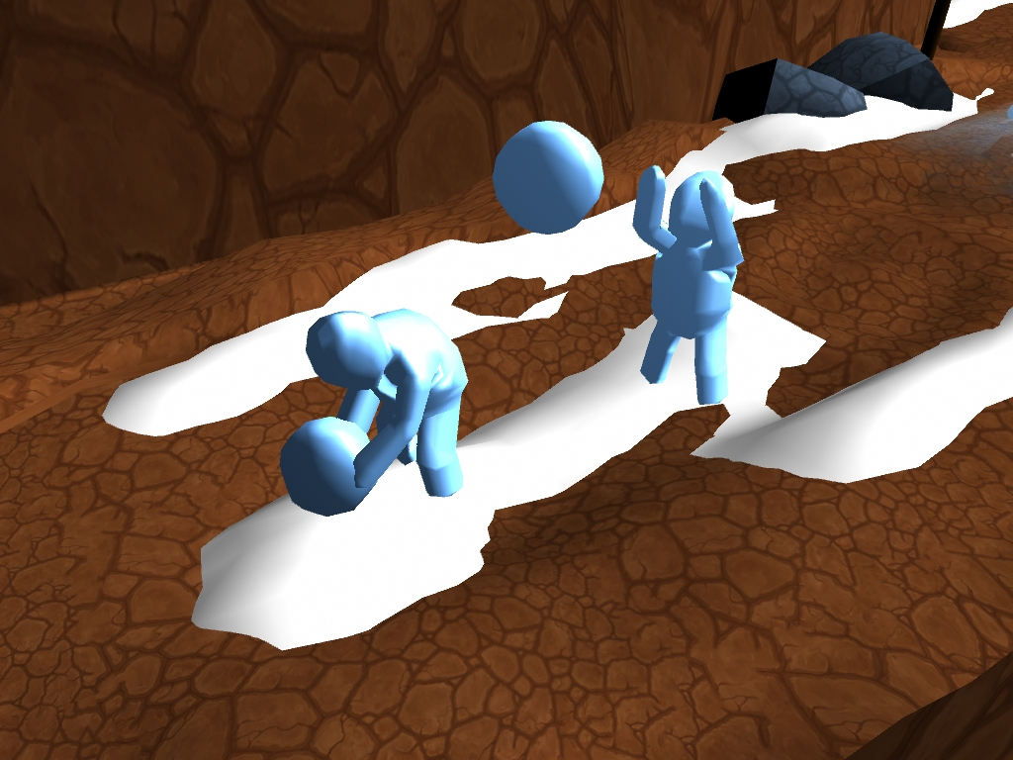
Ice Beast
A big hulking beast made of ice.
Throws snowballs at the player that does massive damage and slows the player down.

Slide 9
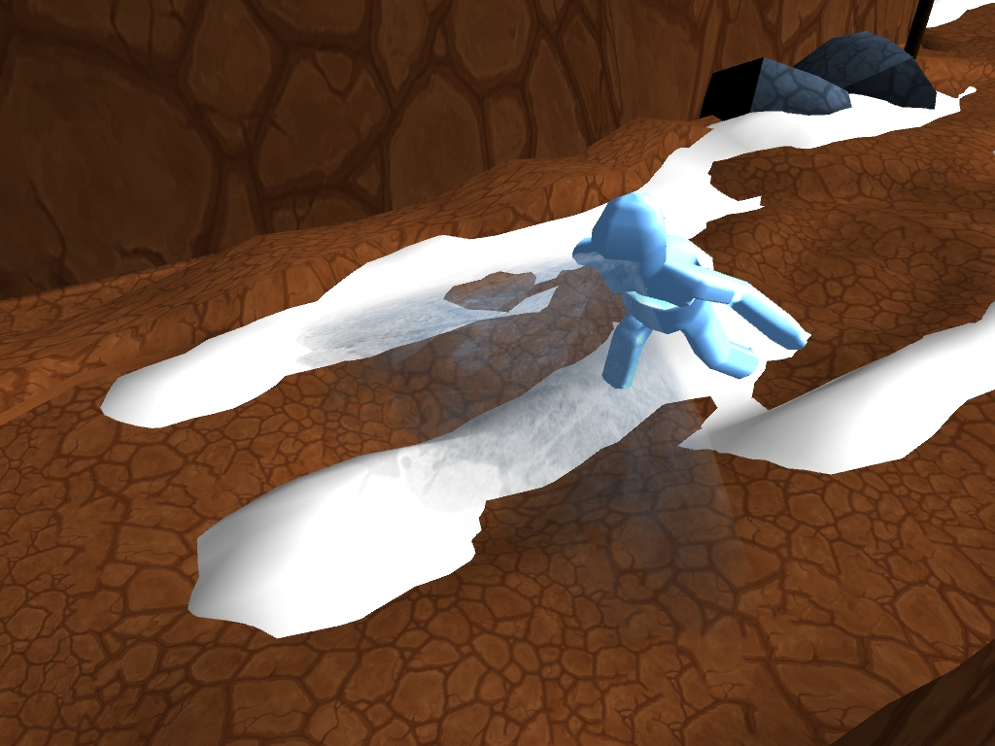
If the player is too close he will use his ice breath that can freeze the player.
Ice will cause it to become stronger.
Fire will be needed to defeat it.

Slide 10
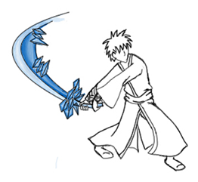

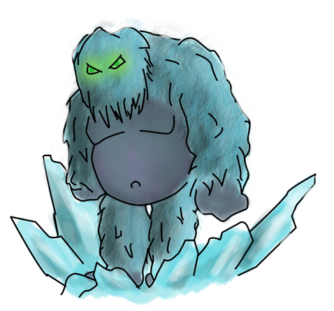

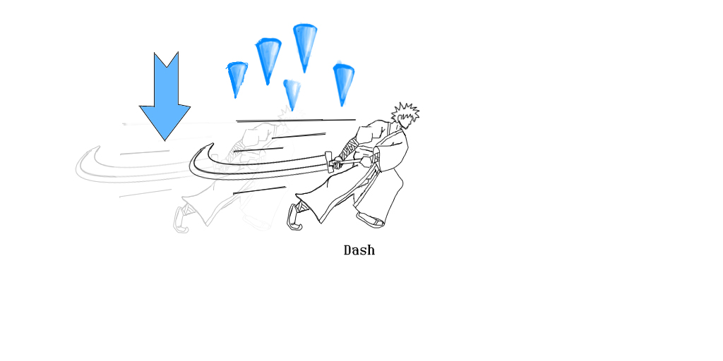
+
Watch Out! Don’t fight ice with ice
=
Too bad for you!

Slide 11
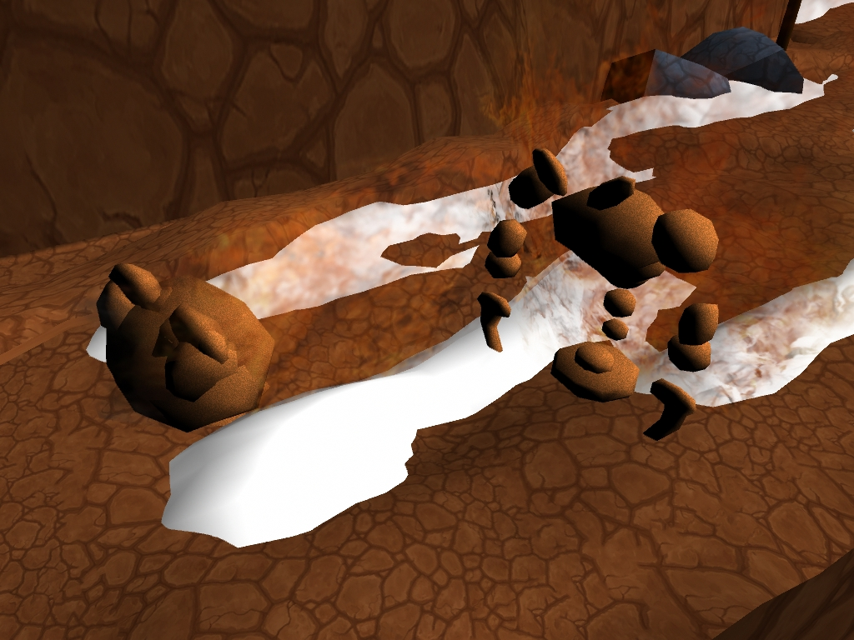
Fire Beast
That’s how I roll!
A creature composed entirely of fire and rock.
Does massive damage to the player by turning into a ball and charging.
While on fire may cause the player to catch on fire.
Fire will cause it to get stronger.
Ice will be needed to defeat it.

Slide 12
The Wizard
A human wizard adept in the arts of both fire and ice.
Has multiple stages in which the player must overcome.
Both fire and ice will be needed to defeat him.

Slide 13
Introduction
Music begins to play as game starts up.
The camera fades in to the main character standing at the base of the mountain.
The sound of wind is heard followed by the wind blowing in the direction the player needs to go.
The player is given control at this point.

Slide 14
Learning to Attack
A sign in the background showing the player how to attack.
3 Melee Minions showing how they attack
A thump sound is heard
The player must defeat all enemies in one area to advance.
Wind advises the player to advance.

Slide 15
Learning to Deflect
A sign in the background showing the player how to deflect.
Two ranged enemies standing off in the distance attacking
The sound of a spell being cast.
Player must use deflect to defeat them using the correct element based on color.

Slide 16
Learning to Dash
The sound of lava erupting.
A sign in the background showing the player how to dash.
An explosive minion walks into the lava causing itself to explode.
Player must use dash to advance.

Slide 17
The First Actual Fight
A mixed wave of enemies
2 Melee Minions
2 Ranged Minions

Slide 18
Ice
An Ice Beast enters and walks over an ice trap.
The sound of ice cracking.
Three ice spikes come up buffing the Ice Beast.
The Player must use fire to debuff and kill the Ice Beast.

Slide 19
Fire
A Fire Beast enters to attack the player.
The player must use ice to extinguish and kill the Fire Beast.

Slide 20
Encounter
A mixed wave of enemies
2 Melee Minions
2 Explosive Minions
1 Ranged Minion
1 Ice Beast

Slide 21
Encounter
A mixed waves of enemies
3 Melee Minions
2 Explosive Minions
1 Ranged Minion
1 Fire Beast

Slide 22
Ice Trap Encounter
Player enters in front of an ice trap.
Player must use dash to get across.
A mixed wave of enemies
2 Melee Minions
3 Explosive Minions
2 Ranged Minions
1 Ice Beast

Slide 23
Lava Trap Encounter
4 Lava Traps
10 Melee Minions

Slide 24
Environment Challenge
8 ice traps along a narrow path way.
3 Ranged Minions off on a separate platform.
Player can advance without killing enemies.

Slide 25
Turning Up the Difficulty
A mixed wave of enemies
3 Melee Minions
2 Explosive Minions
3 Ranged Minions
2 Fire Beasts

Slide 26
Encounter
A mixed wave of enemies
5 Melee Minions
2 Explosive Minions
2 Ice Beasts

Slide 27
Encounter
A mixed wave of enemies
3 Melee Minions
2 Explosive Minions
4 Ranged Minions
2 Fire Beasts
1 Ice Beast

Slide 28
Encounter
A mixed wave of enemies
3 Melee Minions
3 Explosive Minions
3 Ranged Minions
1 Fire Beast
2 Ice Beasts

Slide 29
Final Encounter
A mixed wave minions
4 Melee Minions
4 Explosive Minions
4 Ranged Minions
2 Fire Beasts
2 Ice Beasts

Slide 30
For Boss Time!
The Wizard Enters with his opening dialogue
The sound of traps activating.
Wizard calls forth fire and ice to make the player dodge around.
After some casting he grows tired and must recover, player can now attack him
After he has recovered causes an area of effect, player can be stunned if too close.

Slide 31
This isn’t even My Final Form!
Wizard opens with his second bit of dialogue.
The sound of a shield rising
His shield must be disabled with his own attacks (3 times).
Player must use the same attack when deflecting.
Using the same attack enhances the attack, using the opposite will destroy it.
After he has recovered causes an area of effect, player can be stunned if too close.

Slide 32
It’s not over Yet
The sound of something getting bigger
The wizard transforms into a giant.
He slams his fists into the ground.
Takes a few seconds to lift his hands up
Left fist is fire.
Right fist is ice.
Player must use the opposite element

Slide 33
Ending
The wizard gives his final words.
Main character is reunited with his love and they embrace each other.
GAME OVER!
Roll credits.
Music Stops

